Slide 1
The Big Bang Fair, 2022
October 2022

Slide 2
Executive summary
This report provides details of the learning from the Big Bang Fair evaluation, including surveys with students and teachers at the Fair, and focus groups with teachers following the Fair.
Over 2,300 students completed the survey at the Big Bang Fair school days, and a further 183 completed a survey at Unlocked. Over 300 teachers from 150 schools also completed a survey and provided feedback for this evaluation.
The Big Bang Fair is an engaging and enjoyable experience for most students.
88% of students said that they enjoyed the Big Bang Fair, and 83% of teachers said that it had engaged their students.
At least 82% of students get a chance to speak to a STEM professional while at the Fair.
Teachers are mostly very positive about their experience of the Fair
80% of teachers rated the Big Bang Fair as good or excellent. 78% of teachers agreed that the Fair has clear links to the curriculum and 88% agreed the Fair highlights the variety & diversity of careers in engineering.
Students learn about careers in STEM
Around 80% of students say they know about what people working in STEM do. 77% of young people agreed that they learned about the role engineers play in creating greener technologies.
62% of young people said they knew which subjects they need to do next to become an engineer, and 96% said they would choose to do at least one STEM subject, given the option.
Teachers feel confident to advise students around STEM careers
Most teachers feel confident advising students around STEM careers, but more are confident about science than technology or engineering. 54% of teachers said they are more likely to suggest a career in engineering to students after attending the Fair.
Students are inspired to do and learn more around STEM
75% of young people agreed that the Fair had made them want to do more STEM activities. 74% of young people agreed that the Fair had made them want to find out more about a career in STEM.
87% of young people said that they were interested in a career in at least one of science, technology and engineering.
Big Bang Unlocked reached a small but highly engaged group of young people.
Those who attended were mostly already taking part in a range of extra-curricular STEM activities. They nearly all enjoyed the Fair and over 90% are interested in a STEM career.
2

Slide 3
Introduction
The Big Bang Fair is a large, annual exhibition which aims to inspire, inform and empower young people to consider engineering and other STEM careers through showcasing a wide range of STEM employers and jobs.
25,868 young people attended the Big Bang Fair in 2022.
388 schools attended the Fair.
46 employer organisations were present at the Fair and interacting with young people.
This report provides findings of a survey conducted with students at the Big Bang Fair, and with teachers, either at the Fair or in the weeks after it.
The survey aimed to understand students’ experiences of the Fair and their attitudes towards Science, technology, engineering and maths careers.
2,353 young people attending the day exhibitions completed a survey, just under 10% of the total attending.
184 young people attending the evening exhibition, Big Bang Unlocked, completed a survey, around 27% of the total attending.
322 teachers and other adults accompanying students from around 150 different schools completed a survey.
3

Slide 4
Who responded to the survey?
The survey was conducted using ipads at a stand on the showfloor. Students were encouraged to complete the survey after spending some time exploring the Fair.
The table below provides a breakdown of the demographics of students who attended the Fair and who completed a survey.
 | Attending the Fair %¹ | Completed survey N (%)
Total | 25,868 | 2,353
EDI school² Yes No Missing | 48% 52% - | 1189 (51%) 1029 (44%) 114 (5%)
Year Group Year 7/S1 Year 8/S2 Year 9/S3 | 28% 35% 38% | 750 (33%) 862 (38%) 661 (29%)
Gender Male Female Non-binary, questioning or self-described | 48% 52% - | 1241 (55%) 906 (40%) 119 (5%)
Ethnicity White Asian/Asian British Black/Black British Mixed or multiple ethnicity Other ethnic identity | 63% 24% 4% 5% 4% | 1302 (59%) 528 (24%) 161 (7%) 153 (7%) 50 (2%)
Receive Free School Meals? Yes No Missing | 30% 70% - | 461 (20%) 1667 (71%) 225 (9%)
1. Demographics for students attending is based on teacher report at registration and is not complete for all attending students. Percentages are based on the information provided.
2. Equality, Diversity and Inclusion criteria, based on student population with higher numbers from groups typically under-represented in engineering. For more detail, see EngineeringUK EDI Criteria - Tomorrow's Engineers (tomorrowsengineers.org.uk)
4

Slide 5
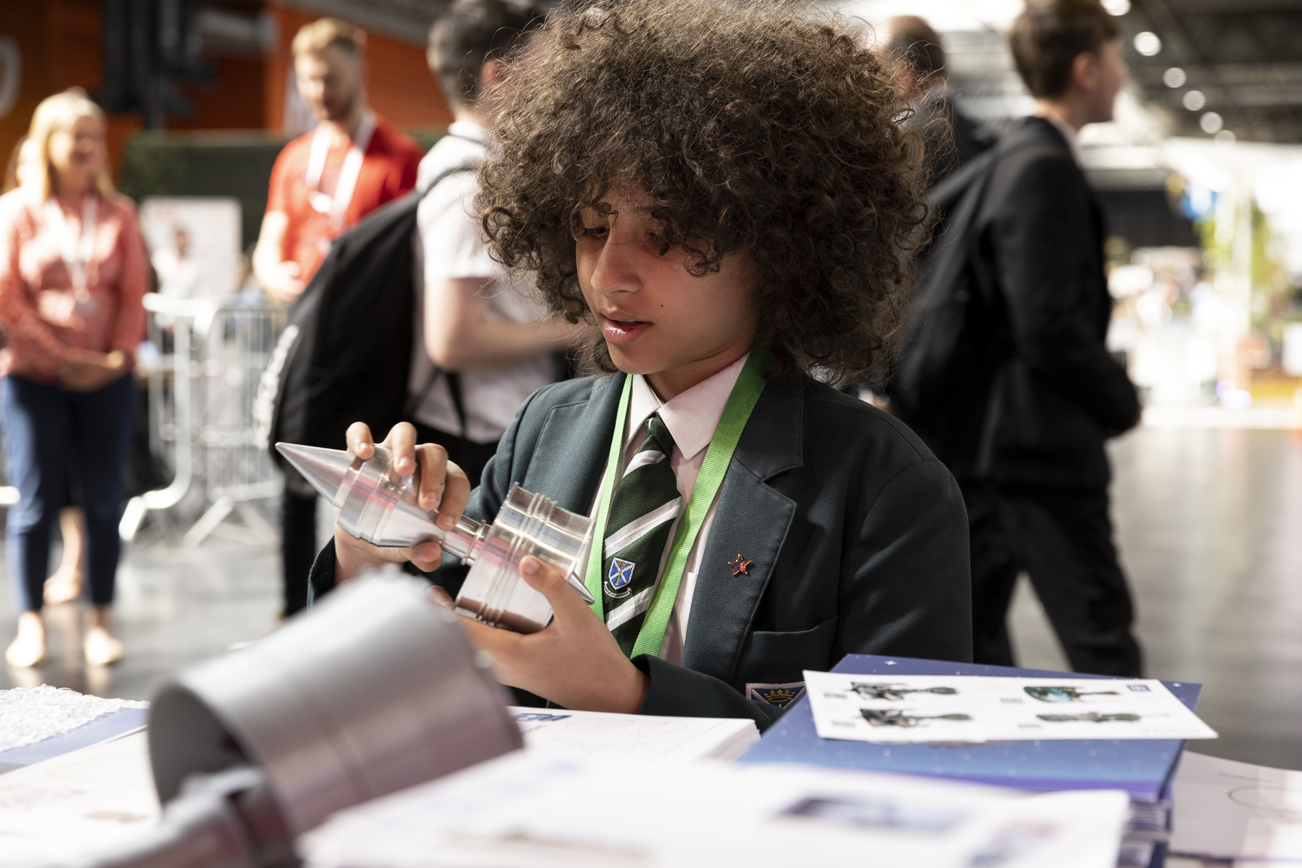
Student and teacher experience of the Fair
5

Slide 6
Students’ experience of the Fair
The programme’s aim to inspire young people to consider further STEM study and careers is based on providing an experience that is enjoyable and engaging to young people. We asked students about their experience of the Fair and ran a logistic regression to identify any factors that predicted their enjoyment of the Fair.
88% of young people agreed that they were enjoying the Big Bang Fair
Though a large majority of students said that they enjoyed the Fair, this was a slight decrease from previous years. Between 2016 and 2019, the proportion of students who said they enjoyed the Fair ranged from 91% to 94%. However, the question wording changed slightly between 2019 and 2022, so care should be taken with this comparison.
Following a logistic regression, knowing someone who works in STEM, high STEM engagement, being from an EDI school, ethnicity and year group all remain significant predictors of enjoyment of the Fair when controlling for other factors.
Holding all other variables constant, the odds of enjoying the Fair were
more than double for students who were categorised as already having high STEM engagement (OR = 2.33, 95%CI 1.48, 3.66, p<.05).
Year 7 students were nearly twice as likely to enjoy the Fair as Year 9 students (OR = 1.97, 95%CI 1.29, 3.00).
Students who knew someone working in a STEM career were around 70% more likely to enjoy the Fair when all other factors were held constant (OR 1.74, 95%CI 1.25, 2.43, p<.05).
Students from an EDI criteria school were 79% more likely to say they enjoyed the Fair compared to those from non-EDI schools (OR = 1.79, 95%CI 1.26, 2.53, p<.05).
When other factors are controlled for, Asian students are around 38% less likely to enjoy the Fair compared with white students (OR=0.62, 95%CI 0.41-0.92, p=.019), and Black students were around half as likely to enjoy the Fair as white students (OR=0.48, 95%CI 0.27-0.85, p=.012).
6

Slide 7
Students’ experience of the Fair
Students may not have completed their exploration of the show floor when completing the survey. The chart below shows the activities that young people said they had taken part in at the Fair.
The opportunity to meet STEM professionals and learn about what they do and how they got there is a key part of how the Big Bang Fair aims to inform and inspire students. Teachers in the focus groups were very positive about their experience of the people running the stands and their ability to engage and communicate with students.
“The actual stalls themselves I thought were brilliant. The volunteers that were there were really engaging for students. Because often adults can’t talk to children, but they all could and it was really nice to see. And you didn’t get the sense that they were just doing it because they were forced to go there; they actually seemed really interested.” [focus group teacher]
“Some of the people on the stands, and particularly the insects one, they were so enthusiastic, and that really did make a difference to a day, because their enthusiasm – well, it was infectious to us as teachers – but the kids, it just sort of ‘oh, well, I might need to know about this then, what is this’. That was a really, really good part to the day.” [focus group teacher]
7

Slide 8
Teachers’ experience of the Fair
Teachers’ rating of the Big Bang Fair is critical, both as the main decisionmakers for attending the Fair in future, and for their insights into how effectively the Fair meets their, and their students’, needs.
How would you rate your experience of the Big Bang Fair overall? – comparison by whether they had attended before (n=288)
80% of teachers rated the Big Bang Fair as good or excellent.
Teachers from EDI criteria meeting schools were slightly more likely to rate the Fair as ‘excellent’, but similar proportions of teachers from all schools gave a positive rating.
Comparison to previous years
We asked teachers if they had personally attended the Fair in previous years. A little more than a third (38%) said that they had. Teachers who had previously attended were less likely to give a positive rating, suggesting that their experience of the Fair was not as good as in previous years.
For teachers who attended the Fair previously, we asked whether the reduced number of students attending had improved their experience of the Fair. 44% said that it had improved their experience, 19% said it had worsened, and 32% said it made no difference.
“It was a lot smaller than previous years, we missed the big science shows that usually happen. There was also too many schools in a small space, some of the students behaviour was very poor from other schools.”
“My colleague, who had been before, she did say that there were fewer students involved with the Big Bang Competition this time around. I actually spoke to a year 9 boy, and I thought he was year 12 or 13 because his project was just amazing. And I walked away thinking the Fair could do more to promote those or have those as a bigger element of the Fair.”
“I thought there would be a few more stalls. I went when you had the Dr Who thing on. That was brilliant. And I would have thought there would be a bit more of that.”
8

Slide 9
Teacher’s experience: student engagement
Teachers gave a lot of positive feedback about the number and range of stands and activities on offer at the Fair and how engaging these were for students.
83% of teachers agreed that the Fair is engaging for their students.
Around one in five teachers said that they felt the Fair was more engaging for boys than girls, compared with around two in five who disagreed with this.
“Lots of activities. Lots of information.”
Many of the positive comments were around the diversity of stands and how engaging they were for students. Though some teachers caveated their comments with reference to the queues and over-crowding, most felt that the range on offer was very good. The interactive, hands-on activities were particularly appreciated by teachers.
In general, there was a lot of praise for range of the activities on offer which were felt to engage students very well.
“Students really enjoyed the different exhibits and came away very enthused by all the different oppurtunities in STEM.”
“The stalls were fantastic. Students were engaged and very eager to participate. The freebies on offer were brilliant and the activities very interesting. There was something for everyone!”
“I thought there was a really good range of things as well that with the sort of cyber security sort of stuff and all the technology based things and then the science and hands on things as well, there's a good range.” [Focus group teacher]
9

Slide 10
Teachers’ experience: Curriculum links and careers information
The content of the Fair aims to support schools’ and teachers’ objectives through providing clear curriculum links and showcasing STEM careers.
78% of teachers agreed that the Fair has clear links to the curriculum.
88% agreed the Fair highlights the variety & diversity of careers in engineering
“Good range of stem careers”
Several teachers indicated that their students had identified and learned about potential STEM careers for them. Being able to speak to ‘real scientists’ was an important part of this showcasing.
At the point of completing the survey, fewer than half of the teachers had accessed a careers panel for teachers. Among those that had 82% said that they found them helpful or very helpful.
A small number of teachers said that they didn’t feel there was enough information for careers leads, for instance on career pathways.
“The opportunity to talk to industry professionals makes the experience feel authentic, students respond well to adults explaining that their school interest helped them build a career.”
“Plenty of STEM opportunities and careers for students to actively get involved in. Worthwhile conversations are happening alongside taster sessions which help students gain an insight to these sectors”
“There’s a broad range of backgrounds at the fair which gives students an insight into the many avenues that STEM can open for them.”
“Came as Careers Lead - very little info on careers - lots of activities for students to inspire but not much info on pathways.”
10

Slide 11
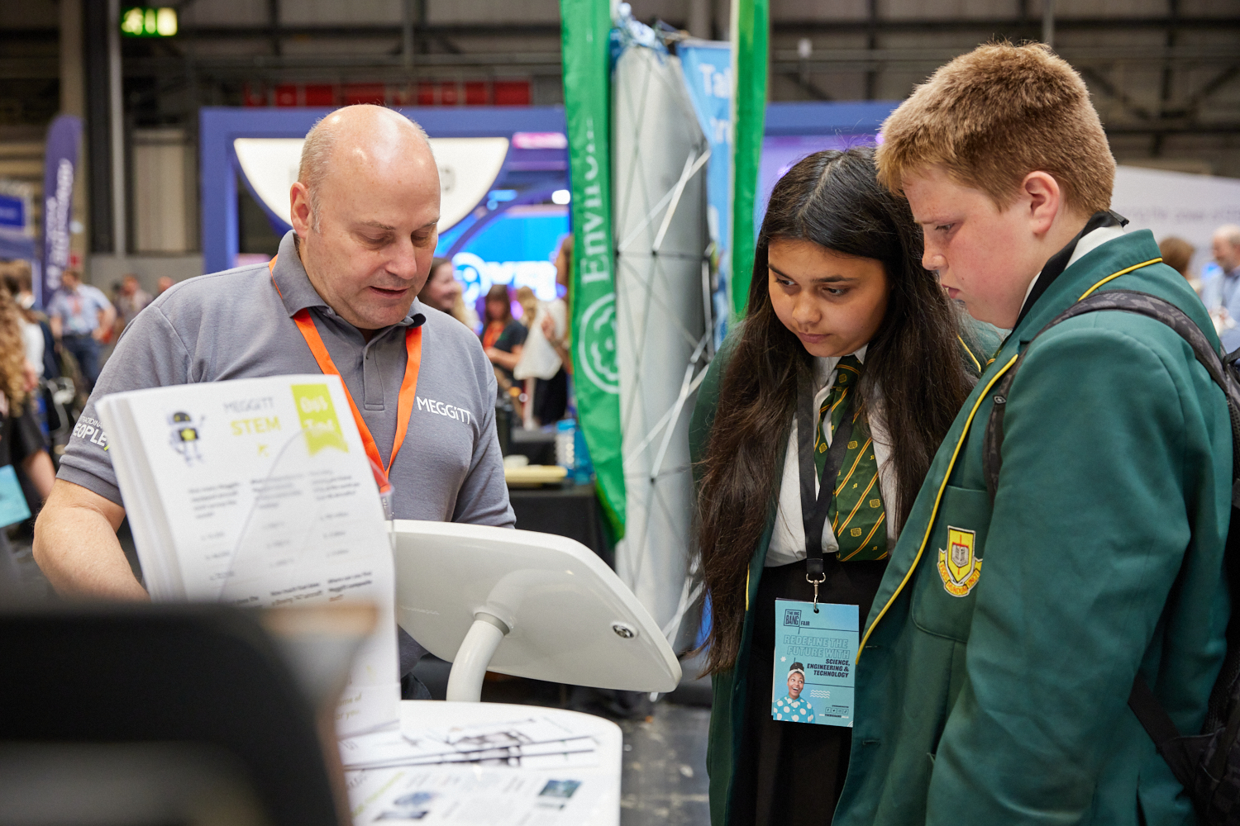
Informing, inspiring and empowering students
11

Slide 12
Informing students
Through the activities and stands the Fair aims to inform teachers and students about STEM careers, what they entail and what they can achieve.
77% of young people agreed that they learned about the role engineers play in creating greener technologies.
A large majority of students say that they know about the kinds of things that STEM professionals do. For science, engineering and technology, only 6% of young people responded that they didn’t know about what people did in these careers.
The proportion of young people who say they know about these careers has increased compared with attendees at the 2019 Big Bang Fair (scientists: 66%; engineers: 55%; technology: 60%).¹
The most recent Engineering Brand Monitor², conducted in 2021, asked a representative sample of 11-14 year olds the same question. Around 53% agreed that they know about the different things engineers do, 62% knew about what scientists do, and
62% knew about what people working
in technology do. This suggests that those attending the Fair have a substantially better awareness of these careers.
We cannot objectively assess students’ knowledge or compare what they know after the Fair with what they knew before. However, if students feel more informed, even if only around some specific STEM careers that interest them, this opens up opportunities that would otherwise not be available to them.
The Fair featured a number of stands with an environmental theme, and over three-quarters of students said that they learned about the role engineers play in creating greener technologies.
1. Some care should be taken with this direct comparison as the question wording was changed. The previous question asked “How much would you say you know about what people working in the following areas do?”, compared responses were I know a bit / I know a lot about it.
2.EngineeringUK. (2022). EngineeringBrand Monitor. euk2708-parents-report-fv.pdf (engineeringuk.com)
12

Slide 13
Informing students
For students who may be inspired to pursue a STEM career, knowing what they need to do to follow that career path is essential, particularly as some relevant subject choices are made by the end of Year 9.
62% of young people said they knew which subjects they need to do next to become an engineer.
Female students | Male students
1. Design & Technology (56%) | 1. Computing (59%)
2. Biology (46%) | 2. Maths (54%)
3. Maths (45%) | 3. Design & Technology (50%)
4. Chemistry (41%) | 4. Physics (42%)
5. Computing (34%) | 5. Chemistry (37%)
6. Physics (30%) | 6. Biology (31%)
7. None of these (6%) | 7. None of these (3%)
Most students said they knew which subjects they would need to study to pursue a carer in engineering, though around 14% said that they did not know.
In contrast, the 2021 Engineering Brand Monitor found that among a representative sample of young people, only 38% knew what subjects they would need to take.¹
By Year 9, students will typically have had to think about what subjects to take at GCSE. While some subjects are compulsory at GCSE (maths and sciences), others are optional, including computing and design & technology.
We asked students which subjects they would choose to study, given the option. The table above shows the breakdown by gender. Nearly all students (96%) would choose to study at least one of these subjects.
The breakdown shows that some subjects continue to be gendered, even among this relatively highly STEM engaged group of students. Computing is far more popular among male students (59% compared to 34%), while biology is more popular among female students (46% vs 31%).
This pattern is reflected in the wider population of students in England and Wales. In 2020/21, only 21% of all entrants to computing GCSEs were female, while female students made up over 60% of those choosing biology at A-level.²
EngineeringUK. (2022). Engineering Brand Monitor. euk2708-parents-report-fv.pdf (engineeringuk.com)
EngineeringUK. (2022). Secondary Education Excel Resource. https://www.engineeringuk.com/research-policy/educational-pathways-into-engineering/secondary-pathways-into-engineering/
13

Slide 14
Informing teachers about STEM careers
Teachers play an essential role in advising and supporting students in their career choices. They need to understand STEM careers and feel confident to provide STEM careers advice to help increase the numbers of students pursuing STEM.
54% of teachers said they are more likely to suggest a career in engineering to students after attending the Fair.
How confident do you feel giving advice about careers in the following areas?
Over three-quarters of teachers (76%) agreed that their school supports students to develop the skills they would need to pursue engineering. Only 17% strongly agreed, however, which suggests that many feel there is room to do more.
Most teachers said they knew about what STEM careers involve: 87% said they knew about what scientists do in their jobs, 82% knew about what engineers do and 76% knew about what people working in technology do. This pattern was similar across EDI and non-EDI schools.
Teachers also agreed that they knew about what subjects students would need to pursue a career in science (84% agreed) and in engineering (82% agreed).
The majority of teachers feel confident giving advice around STEM careers, but there is less confidence around engineering and technology careers compared with science careers.
Around 44% of teachers said they felt more confident giving engineering advice after having attended the Big Bang Fair.
Among teachers who said they had a responsibility for providing careers advice in their school, 86% said that they had suggested to a student that they consider a career in engineering in the last couple of years. However, this was slightly higher among non-EDI schools compared to EDI schools (90% vs 82%).
Over half of the teachers who said they had careers advice responsibilities said they were more likely to suggest an engineering career to students after having attended the Fair.
14

Slide 15
Inspiring students
The Fair aims to inspire students towards further STEM study and careers. In the short-term, however, inspiring students may be more likely to affect their immediate interest in STEM activities. We asked students whether the Fair made them want to do more activities in science, technology, engineering and maths.
75% of young people agreed that the Fair had made them want to do more STEM activities.
A logistic regression showed that when holding all other variables constant, knowing someone who works in STEM, reporting medium or high STEM engagement and attending an EDI school remain significant predictors of wanting to do more STEM activities.
Students who reported high STEM engagement prior to the Fair were more than four times more likely than those reporting low STEM engagement to say that the Fair made them want to do more (OR = 4.22, 95%CI 3.02, 5.90, p<.05).
Students reporting medium STEM engagement were nearly two and half times as likely to want to do more STEM activities following the Fair than those reporting low STEM engagement (OR = 2.43, 95%CI 1.75 3.36, p<.05).
Knowing someone who works in a STEM career increased the odds of wanting to do more STEM activities by around 33% when all other factors were held constant (OR = 1.33, 95%CI 1.02, 1.71, p<.05).
Students who attended an EDI school were 40% more likely to agree that the Fair made them want to do more STEM activities compared with students from a non-EDI criteria school (OR = 1.40, 95%CI 1.08, 1.82, p<.05)
15

Slide 16
Inspiring students
For students who may have been inspired to consider a career in STEM, finding out more about how to pursue this is an important next step. We asked students whether the Fair made them want to find out more about a career in STEM.
74% of young people agreed that the Fair had made them want to find out more about a career in STEM.
Following a logistic regression, knowing someone who works in STEM, medium and high STEM engagement categories remain significant predictors of wanting to find out more about STEM careers.
Holding all other variables constant, the odds were more than three and half times higher for students who were already categorised as having high STEM engagement (OR = 3.74, 95%CI 2.68, 5.21, p<.05).
Students categorised as having medium STEM engagement were nearly two and a half times as likely to want to find out more about STEM careers (OR = 2.46, 95%CI 1.77 3.42, p<.05).
Knowing someone who works in a STEM career also increased the odds of wanting to find out more by around 50% when all other factors were held constant (OR 1.52, 95%CI 1.18, 1.95, p<.05).
No demographic characteristics were significant predictors in the model.
16

Slide 17
Inspiring students
We asked students how interested they are in a career in science, engineering or technology related fields. For the purposes of the regression, we looked at students who were interested in any STEM career in contrast with those who said they were not interested in any.
87% of young people said that they were interested in a career in at least one of science, technology and engineering.
The chart above shows that between 60% and 70% of students attending the Fair were interested in the different fields of STEM-related career. In contrast, the latest EBM shows that 55% of 11-14 year olds were interested in a career involving science, 63% were interested in a career in technology and 55% were interested in a career in engineering.
Following a logistic regression, knowing someone who works in STEM, medium and high STEM engagement categories and gender remain significant predictors of interest in any STEM-related career.
Holding all other variables constant, the odds of being interested in a STEM career were more than six times higher for students who were already categorised as having high STEM engagement (OR = 6.34, 95%CI 4.05, 9.93, p<.05).
Students categorised as having medium STEM engagement were more than twice as likely to want to find out more about STEM careers (OR = 2.42, 95%CI 1.65, 3.57, p<.05).
Knowing someone who works in a STEM career more than doubled the odds of being interested in a STEM career when all other factors were held constant (OR = 2.18, 95%CI 1.55, 3.05, p<.05).
Female students were around half as likely to say they were interested in a STEM career as male students (OR = 0.51, 95%CI 0.36, 0.72, p<.05).
Students who identified as non-binary were around 70% less likely to be interested in a STEM career (OR=.28, 95%CI 0.13, 0.36, p<.05).
17

Slide 18
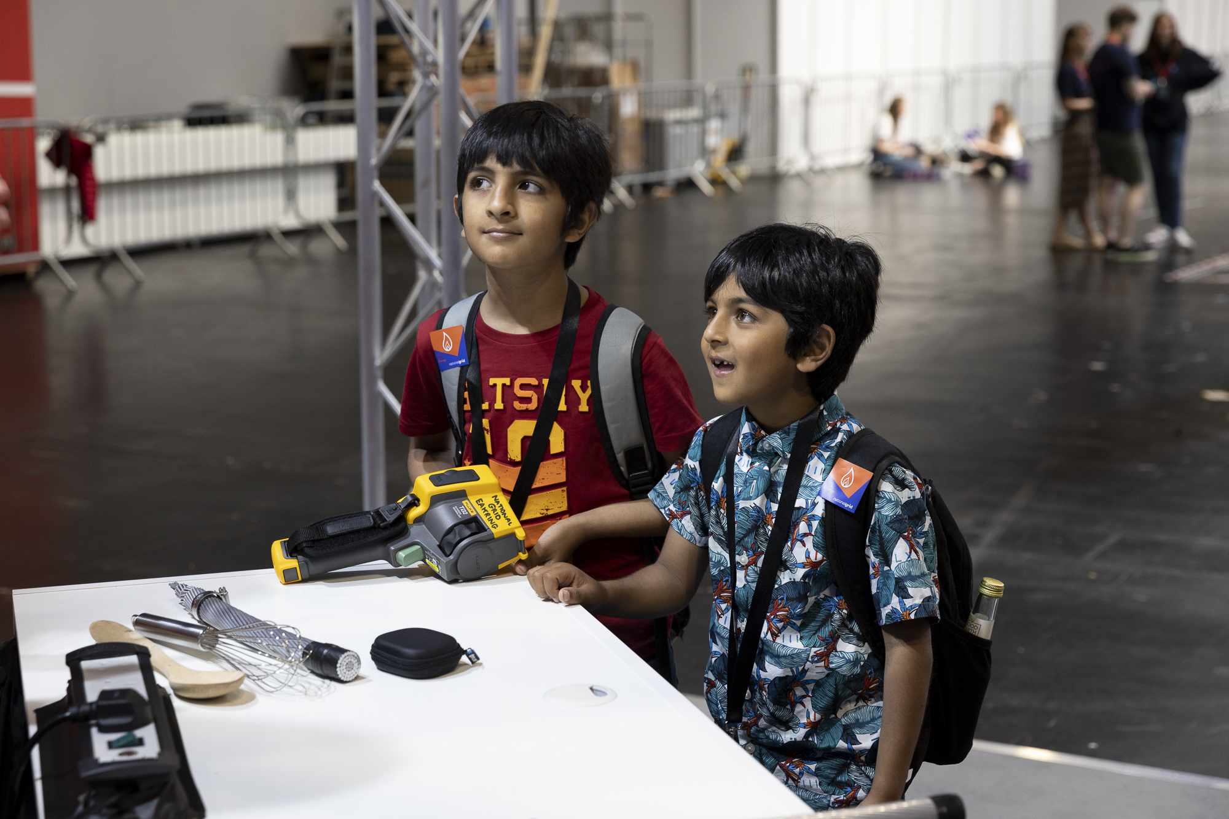
Big Bang Unlocked
18

Slide 19
Big Bang Unlocked: Who responded to the survey?
As with the school days, the survey was conducted using ipads on the show floor, primarily near the exits to capture the views of young people as they were leaving.
The table below provides a breakdown of the demographics of students who completed a survey at Big Bang Unlocked.
 | N (%)
Total | 183
Year Group Primary school Year 7 Year 8 Year 9 Year 10 and up | 43 (24%) 32 (17%) 36 (20%) 39 (21%) 33 (18%)
Gender Male Female Non-binary, questioning or self-described | 83 (47%) 88 (49%) 7 (4%)
Ethnicity White Asian/Asian British Mixed or multiple ethnicity Black/Black British Other ethnic identity | 111 (64%) 36 (21%) 15 (9%) 8 (5%) 3 (2%)
Receive Free School Meals? Yes No Prefer not to say | 25 (14%) 143 (79%) 8 (4%)
Big Bang Unlocked was open to a wider age range of students than the day sessions. Families often brought siblings along who might be outside the target age range but who participated fully in the event.
There was a more even mix of girls and boys compared to the school sessions. Unlocked also had a greater proportion of white students and a lower proportion of students receiving free school meals compared with the day sessions.
STEM activity
Unsurprisingly, young people who attended Unlocked had comparatively high prior STEM engagement. On average, young people engaged in 3.7 of the listed activities. This was slightly higher for boys (3.9) compared to girls (3.5).
Over two-thirds (69%) of young people who responded to the survey were categorised as having High levels of STEM activity compared with 47% at the day sessions. Only 6% did not engage in any of the listed activities compared with 17% at the day sessions.
19

Slide 20
Big Bang Unlocked
The attendance at the Unlocked event was severely impacted by train strikes. As a result the event was much less busy than the school day events and provided easier opportunities to speak with exhibitors and engage in more activities.
95% of young people agreed that they were enjoying Big Bang Unlocked
Young people overwhelmingly said that they enjoyed Big Bang Unlocked. There was no difference in the reported enjoyment by gender (male:94%; female: 94%).
Nearly all (95%) the young people at Big Bang Unlocked had spoken to someone who works in STEM career. Two-thirds (68%) said they had done some or all of the Big Bang Explore activity list.
Around three-quarters of young people (74%) said they had watched a live experiment or demonstration. 90% said they had taken part in an interactive activity.
Just over a third (38%) of young people at Unlocked said they had watched a careers panel on the stage. In total, 42% of young people said they had visited a Big Bang Ideas Factory, but girls were more likely to say they had done this than boys (male: 37%; female: 48%).
We asked young people about their favourite activity. Responses were extremely diverse, covering most of the stands attending. Though Slime Club, Army and NetworkRail were the most commonly mentioned, there was no clear gap between these and other stands. As with the day sessions, lots of mentions could not be linked to specific stands but highlighted that many young people particularly enjoyed stands that involved robots and coding.
“Rolls Royce stand Showed me a lot of new things that I can take on in the future and helped me to understand a lot of things about aviation and science etc”
“I loved going to the Big Bang. One of my favourite stands was the discover materials. I learnt a lot and it was way fun and engaging”
“I enjoyed the ambulance stand, because the paramedic we spoke to answer a lot of questions. It also gave me an idea for what I want to do when I’m older.”
“I really enjoyed the Physics in the Freezer stand it was so fascinating and really engaging! I learnt so much and now I really want to explore and learn more about Physics! It was amazing!”
20

Slide 21
Big Bang Unlocked
The evening event, open to families and home educators took place on the Thursday evening. The attendance at the Unlocked event was severely impacted by train strikes. As a result the event was much less busy than the school day events.
82% of young people said that Big Bang Unlocked had made them want to do more STEM activities
82% of young people said that Big Bang Unlocked had made them want to find out more about STEM careers
Though slightly more girls (84%) than boys (80%) said that they wanted to do more STEM activities following Big Bang Unlocked, this is a small difference given the overall numbers taking part in the survey. There was a slightly more marked difference by age group, ranging from 88% of students in year 10 and up to 77% of those in year 8, however, the numbers in each age group mean we should be cautious drawing any conclusions from this difference.
A very similar pattern was found in young people saying that Big Bang Unlocked had made them want to find out more about STEM careers: 84% of girls and 79% of boys agreed with this statement. Year 9s were
most likely to agree (87%) and Year 8s slightly less likely (77%), but again, these differences are very small.
79% of young people said that they had learned about the role engineers play in creating greener technologies. This was lowest among year 7s (66%) and highest among year 9s (90%).
Over 80% of young people responding to the survey said they knew about the types of things that scientists, engineers and people working in technology do in their jobs. Boys are more likely to say they know about what’s involved in each of these STEM areas, though the gap is slightly smaller in relation to science careers.
I know about the types of things the following people do in their jobs (n=166)
21

Slide 22
Big Bang Unlocked
Since Big Bang Unlocked tends to be attended by families and young people with an existing interest in STEM and STEM careers, it is unsurprising that young people have a high level of interest in pursuing a STEM career themselves. However, there is a clear gap between boys and girls attending Unlocked.
91% of young people said they were interested in a career in at least one of science, technology or engineering.
69% of young people believed that they could become an engineer if they chose to.
Although girls are just as likely to enjoy Big Bang Unlocked as boys, there is a substantial gender gap when it comes to considering STEM careers. Girls who responded to the survey were less likely to be interested in a STEM career than boys, and this gap was much larger for engineering (male: 84%; female: 61%) and technology (male: 89%; female: 65%) compared to science (male: 80%, female: 76%).
There is also a gap between boys’ and girls’ belief that they could become an engineer if they chose to. 78% of boys said they probably or definitely could, while only 61% of girls said they probably or definitely could.
How interested are you in a career that involves any of the following? (n=162)
22

Slide 23
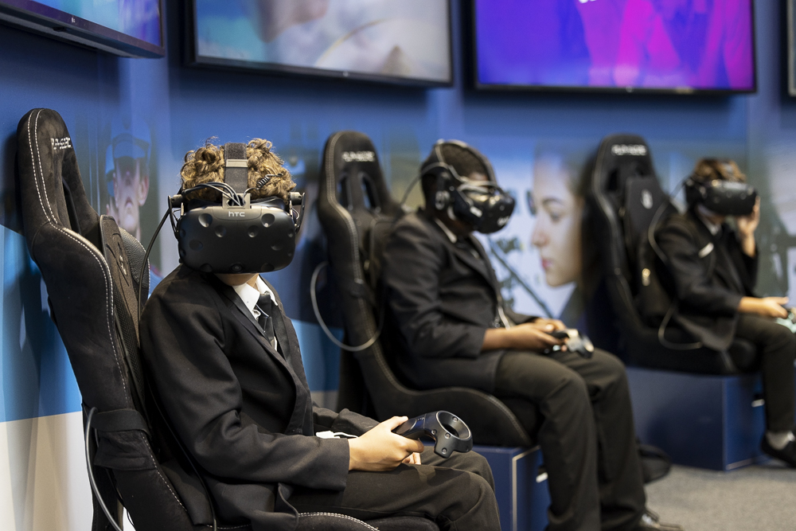
Conclusions
23

Slide 24
Conclusions
Our evaluation suggests that the immediate outputs of the Fair for students – accurate information, an enjoyable experience and opportunities to meet STEM professionals – were achieved to a large extent.
‘accurate information about a wide range of STEM careers’
The Fair showcased a wide range of STEM fields and professions, and the feedback on favourite activities suggests that students with diverse interests were able to find activities and stands that engaged them. The large majority of teachers agreed that the Fair highlighted a diverse range of STEM careers.
‘An engaging and enjoyable experience’
88% of students said that they enjoyed the Big Bang Fair, and 83% of teachers said that it had engaged their students.
Student enjoyment is down slightly compared to 2019, and some of the feedback in this report may help to explain this, in particular the smaller number of exhibitors, the crowded show floor and the queues for popular activities. Despite these, overall enjoyment is high.
However, it is important to be aware of which student groups might not be experiencing the Fair as positively as others.
The Fair, not surprisingly, is particularly engaging for young people who are already interested in STEM activities and who already engage in STEM in multiple ways. It may, therefore, be more effective at fostering an interest rather than sparking one from nothing.
It is concerning to see that some groups, in particular black students, are less likely to enjoy the Fair. More work is needed to understand why this group is less engaged by the activities on offer.
In contrast, there does not seem to be a significant gender gap in enjoying the Fair. It is interesting that female students tend towards preferring different activities to male students, but it seems that enough of each kind of activity is on offer to provide an enjoyable experience overall. It may be useful to look at whether a similar approach could be used to engage other under-represented groups, including students from minority ethnic groups, by finding more activities targeted at engaging these groups.
‘…provides contact with a diverse range of STEM professionals’
Student responses show that at least 82% of students get a chance to speak to a STEM professional while at the Fair. Since some of the students will have continued to explore the show floor after completing the survey, it is likely that the actual figure is higher.
24

Slide 25
Conclusions
Short-term outcomes for students focus on increased knowledge about STEM careers, showing that STEM can be enjoyable and that STEM careers are open to anyone. The evaluation findings suggest that most students at the Fair do show the intended knowledge and beliefs, but that this is not equal across all groups.
‘Young people learn about STEM careers and the positive impacts of STEM careers’
Students at the Fair were more likely to feel that they know about STEM careers than other young people, with a 15 percentage point difference compared to EBM participants in knowledge about what scientists do, a 17 percentage point difference in knowledge about what people working in technology do, and a 25 percentage point difference in knowledge about what engineers do.
Over three-quarters of students said they learned about the role of engineers in developing greener technologies. This could be a motivation for some students given the levels of reported commitment to environmental concerns.
‘Young people enjoy taking part in STEM activities’
Three out of four students attending said that the Fair made them want to do more STEM activities. This suggests that enjoyment of the Fair may influence young people’s belief that they would be likely to enjoy other STEM activity.
However, as with the overall enjoyment finding, students who are already more engaged in STEM are more likely to say that the Fair made
them want to do more, again suggesting that the Fair may be more effective at encouraging an existing interest than converting students who are not already interested.
‘Young people believe that a STEM career could be open to them’
Over three-quarters of students agreed that engineering careers are open to people from all backgrounds. This belief is crucial to breaking down stereotypes and supporting students from groups that are currently under-represented in STEM careers to aspire to work in these fields. The importance of this is underlined by the finding that students who believe engineering careers are open to people from all backgrounds are 3 times more likely to think that engineering is a suitable career for them, reinforcing this link in the theory of change.
‘Young people know what they need to do to pursue a STEM career’
62% of attendees at the Fair say that they know what subjects they need to take next to pursue a career in engineering, 24 percentage points higher than young people in the EBM survey.
Three-quarters of students attending the Fair said that it made them want to find out more about STEM careers which is a vital step towards making choices on that career path.
25

Slide 26
Conclusions: Does the evidence support our theory of change?
The theory of change also shows how the Big Bang Fair seeks to influence teachers as an important source of support and advice for students.
Teachers are more knowledgeable and confident to give STEM career advice
Knowledge about what is involved in STEM careers is generally high among those responding to the teacher survey, but there is a gap between knowledge about science careers and knowledge about careers in technology. This gap is reflected in the confidence that teachers feel in giving careers advice across these areas: 78% feel confident advising on science careers but only 60% feel confident giving advice about technology careers and 62% giving advice about engineering careers.
Focusing more efforts on providing information and support for teachers at the Fair around careers in technology and engineering specifically could help to address this gap further.
Teachers are motivated to offer more STEM engagement activities to students
Responses to the teacher survey suggest that most teachers rated the Fair positively, felt that it engaged students and that it supported links to the curriculum. These are all important aspects to encourage teachers to attend this or similar events in the future.
We didn’t ask teachers explicitly about plans for further STEM activities, but the increased motivation among students to do more STEM activity could help to encourage schools to make more available. Currently, however, we do not have any data to show that this is happening in practice.
Teachers believe more students are capable of pursuing STEM careers
As with students, existing stereotypes may encourage teachers to make assumptions about which students are best suited to engineering and other STEM careers. Teachers can also benefit from seeing the diversity of STEM careers and professionals on show at the Fair.
More than half of teachers with a responsibility for providing careers advice say that they are more likely to suggest an engineering career to a student after having attended the Fair. We don’t have data to explore what specifically is influencing this change. It may be through seeing students’ responses to the Fair, being exposed to a wider range of career options or having more knowledge about career pathways.
26

